Slide 1

Project 1:
Hard Drug Use and HAART Treatment
Joe Froelicher

Slide 2
Research Questions and Hypothesis
Question 1: The research team is interested in how treatment response two years after initiating HAART is different between subjects who report using hard drugs, such as heroine and cocaine, at baseline and other subjects, who did not report hard drug use at baseline
Hypothesis: Hard drugs will significantly change each of the measures of quality of life, CD4+ count and viral load, from baseline to two years.
Question 2: Was there significant loss to follow up at year two for the four outcomes of interest, viral load, CD4+ count, SF-36 MCS, and SF-36 PCS?

Slide 3
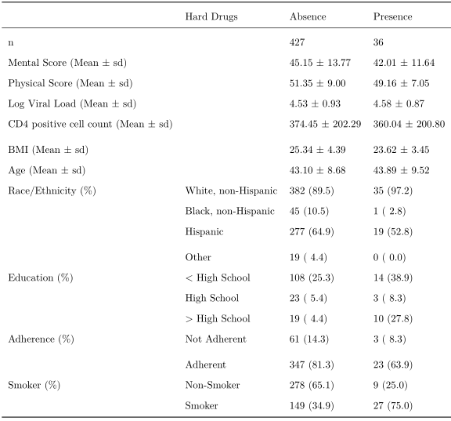
Data
Complete Case analysis
N = 463 individuals
Treatment Responses (Outcome):
CD4+ white blood cell count, viral load, SF-36 aggregate mental score, SF-36 aggregate physical score
Covariates of interest:
Age, BMI, Education, Race/Ethnicity, Smoking Status, Adherence

Slide 4
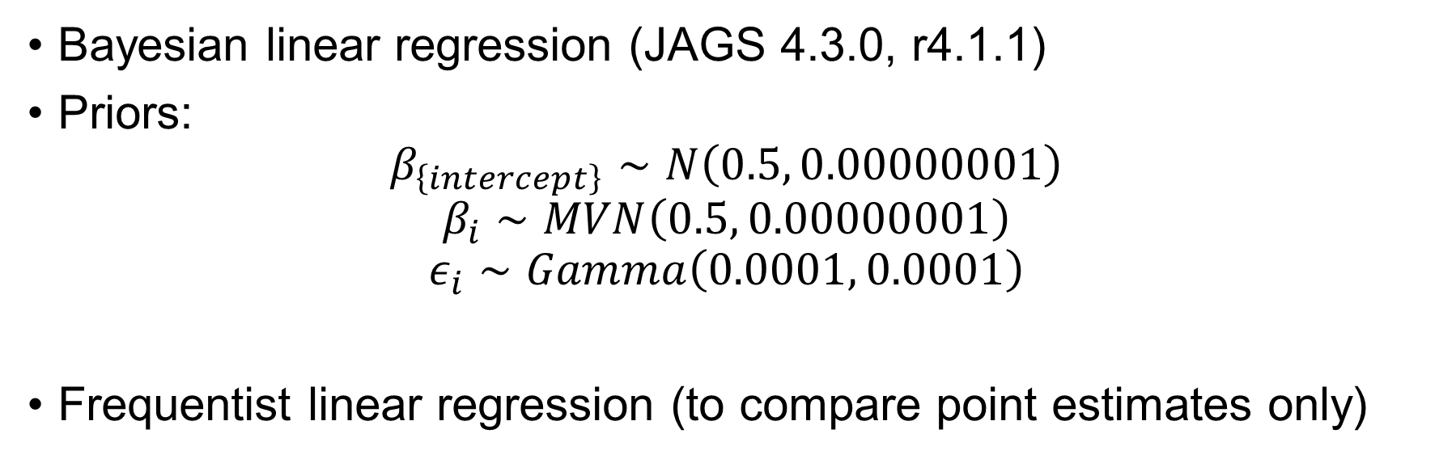
Analysis
Bayesian linear regression (JAGS 4.3.0, r4.1.1)
Priors:
$$β_{\left\{intercept\right\}}∼N\left(0.5, 0.00000001\right)$$
$$β_{i}∼MVN\left(0.5, 0.00000001\right)$$
$$ε_{i}∼Gamma\left(0.0001, 0.0001\right)$$
Frequentist linear regression (to compare point estimates only)

Slide 5
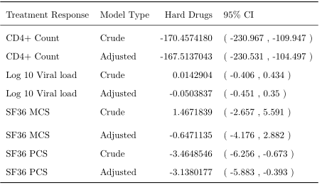
Results: Frequentist Regression

Slide 6
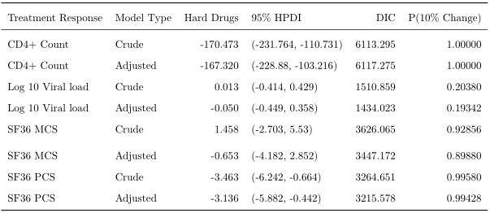
Results: Bayesian Regression

Slide 7
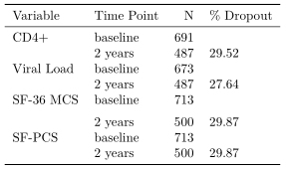
Results: Dropout

Slide 8
Implications
Hard Drugs:
impacts CD4+ cell count and aggregate physical score significantly
Hard drugs had lower impact on aggregate mental score, and much lower on viral count
Bayesian estimation yielded similar results
Promising, this is a more robust technique
The researchers were correct to be concerned about each of the covariates together in a model:
Education, smoking status, adherence, age, BMI, Race/Ethnicity

Slide 9

THANK YOU

